Slide 1
From Mileage to Market Value:
Used Car Price Prediction
This project analyzes used car prices to understand how factors such as mileage, vehicle age, brand, fuel type, and transmission influence market value using Microsoft Excel and Power BI. The dataset was cleaned and prepared in Excel by handling missing values, removing inconsistencies, and creating calculated fields such as car age and depreciation rate. Pivot tables and charts were used to identify initial trends between mileage and price.
The processed data was then visualized in Power BI through interactive dashboards, enabling dynamic analysis of price variations across mileage ranges and vehicle categories. The insights reveal that higher mileage and older vehicles generally have lower resale value, while brand reputation and fuel type significantly affect pricing. This project demonstrates how Excel and Power BI can be effectively used for predictive analysis and decision-making in the used car market without relying on programming tools.

Slide 2
Data Analysis
The data analysis process begins with data collection, where used car data containing attributes such as price, mileage, manufacturing year, brand, fuel type, transmission, and ownership details is gathered from reliable sources. This raw data is then cleaned and prepared in Microsoft Excel by removing duplicate records, handling missing or inconsistent values, standardizing formats, and creating calculated columns such as vehicle age and price depreciation. Excel tools like formulas, conditional formatting, pivot tables, and charts are used to perform preliminary exploration and identify initial trends and patterns.
After data preparation, the cleaned dataset is imported into Power BI for further analysis and visualization. In Power BI, data modeling is performed by establishing relationships between variables, followed by the creation of interactive dashboards and reports. Visual elements such as bar charts, line graphs, slicers, and filters are used to analyze how mileage, age, brand, and fuel type influence used car prices. The final step involves interpreting the insights generated from the dashboards to support data-driven decision-making, helping users understand market trends and predict approximate resale values of used cars.

Slide 3
Data Cleaning
Data cleaning is a crucial step in the data analysis process to ensure accuracy and reliability of results. In this project, the raw used car dataset was first examined to identify and remove duplicate rows, which helped eliminate repeated records that could distort analysis and pricing trends. Duplicate detection was performed using Excel features such as sorting, conditional formatting, and the “Remove Duplicates” tool.
Next, blank and missing values were addressed to maintain data consistency. Records with incomplete or irrelevant information were either corrected, filled where appropriate, or removed to prevent errors during analysis. Finally, outliers in key numerical fields such as price and mileage were identified using statistical methods and visual inspection through charts. Extreme values that did not align with realistic market behavior were reviewed and removed to improve the overall quality of the dataset. These data cleaning steps ensured a refined and reliable dataset for further analysis and visualization in Power BI.

Slide 4
Data modeling
Data modeling is the process of structuring cleaned data to enable efficient analysis and accurate insights. In this project, the cleaned dataset was imported into Power BI, where appropriate data types were assigned to each column to ensure consistency and correctness. Key fields such as price, mileage, vehicle age, and brand were organized to support meaningful comparisons and calculations. Relationships between tables were established where necessary, allowing different attributes to interact correctly during analysis.
Additionally, calculated columns and measures were created to enhance analytical capabilities, such as average price, price depreciation by mileage, and price trends by brand and fuel type. These measures enabled dynamic analysis through filters and slicers. The finalized data model provided a structured foundation for building interactive dashboards, ensuring accurate visualizations and reliable insights into used car price behavior.

Slide 5
Data visualization
Data visualization transforms analyzed data into visual formats that make patterns, trends, and insights easy to understand. In this project, Power BI was used to create interactive and user-friendly visualizations that represent used car price trends based on mileage, age, brand, fuel type, and transmission. Common visuals such as bar charts, line graphs, pie charts, and tables were used to compare prices across different categories, while scatter plots helped illustrate the relationship between mileage and market value.
Slicers and filters were added to allow dynamic exploration of the data, enabling users to analyze specific brands, fuel types, or mileage ranges. These visual elements helped clearly highlight depreciation patterns, brand-wise price differences, and key market trends. Overall, data visualization played a vital role in presenting complex information in a simple and intuitive manner, supporting better decision-making and effective communication of insights.

Slide 6
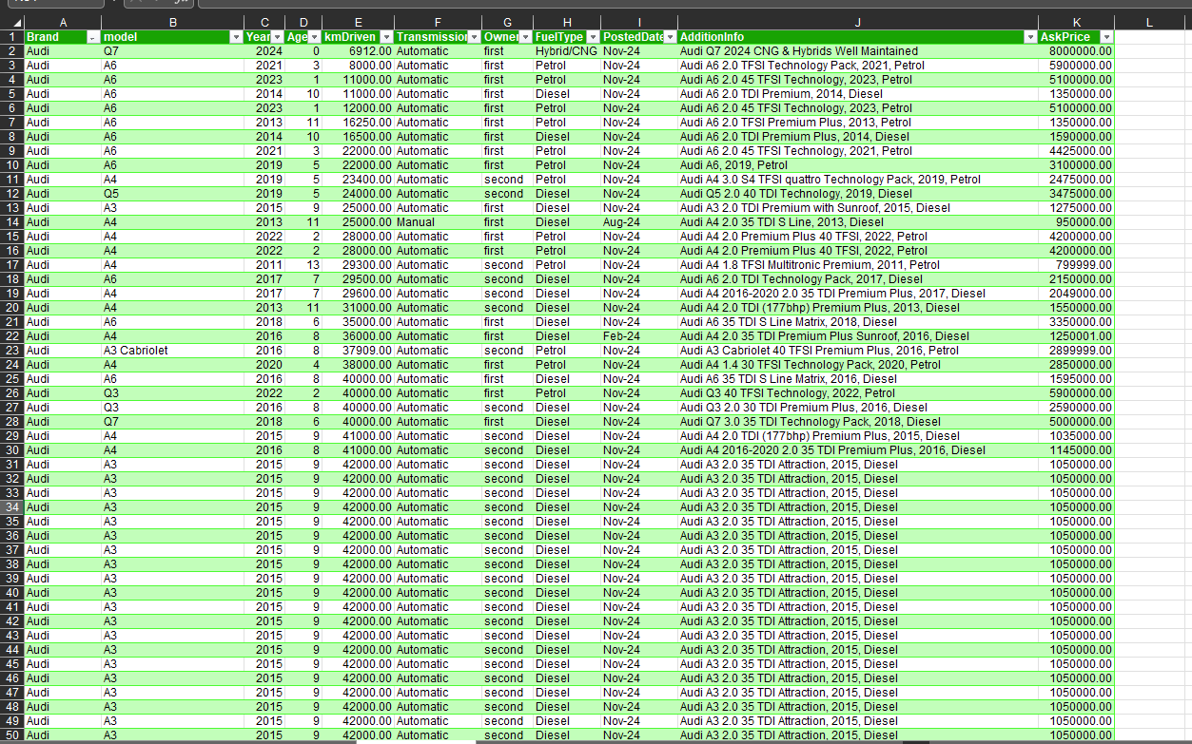
Excel Table

Slide 7
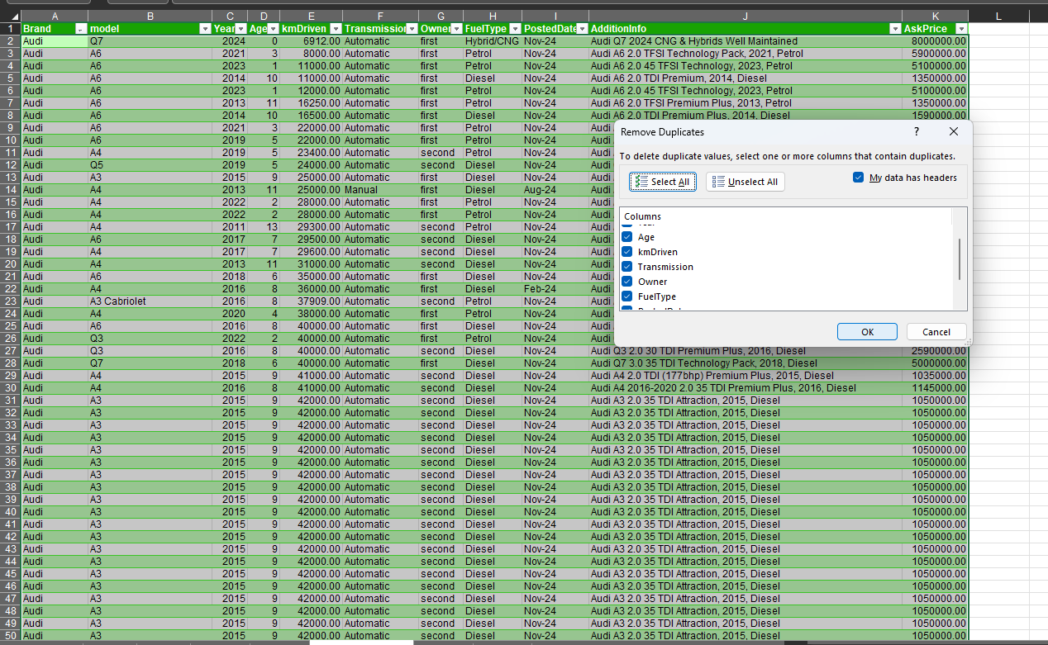
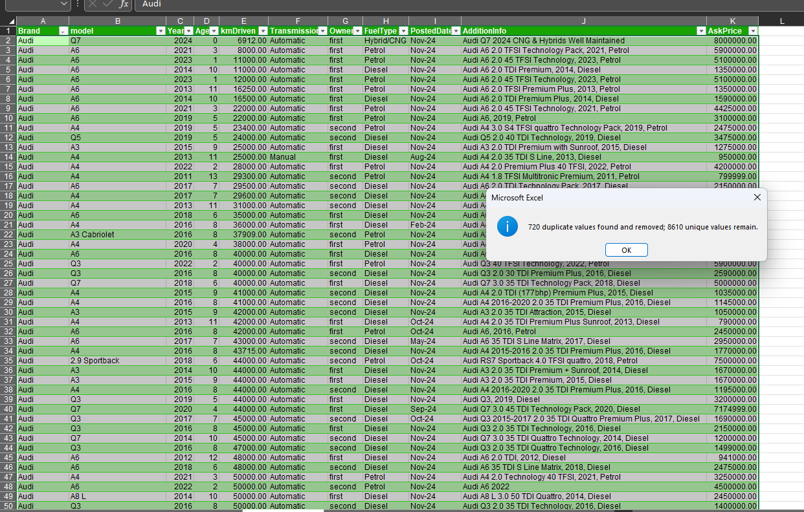
Removing Duplicate Records

Slide 8
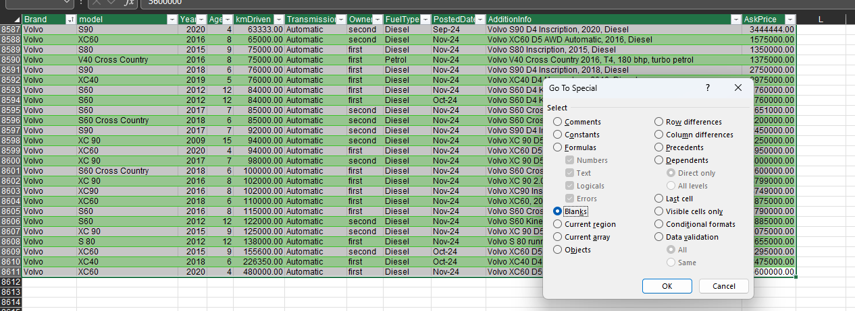
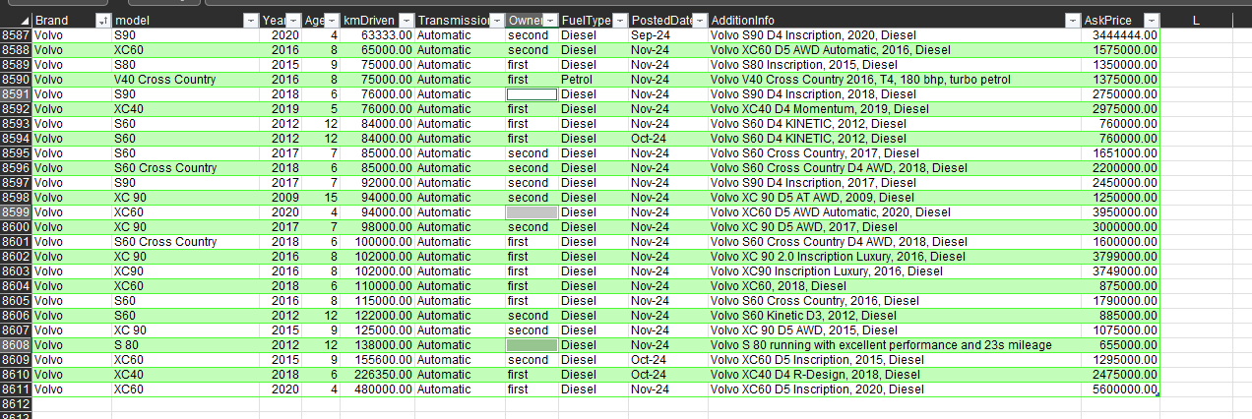
Removing Blanks

Slide 9
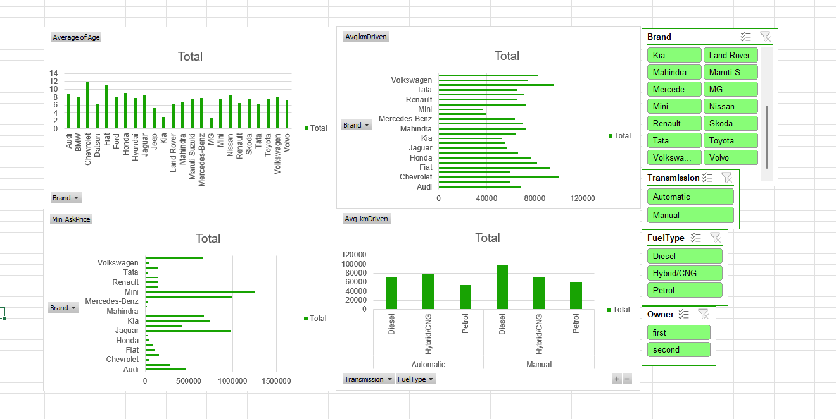
Data visualization in Excel

Slide 10
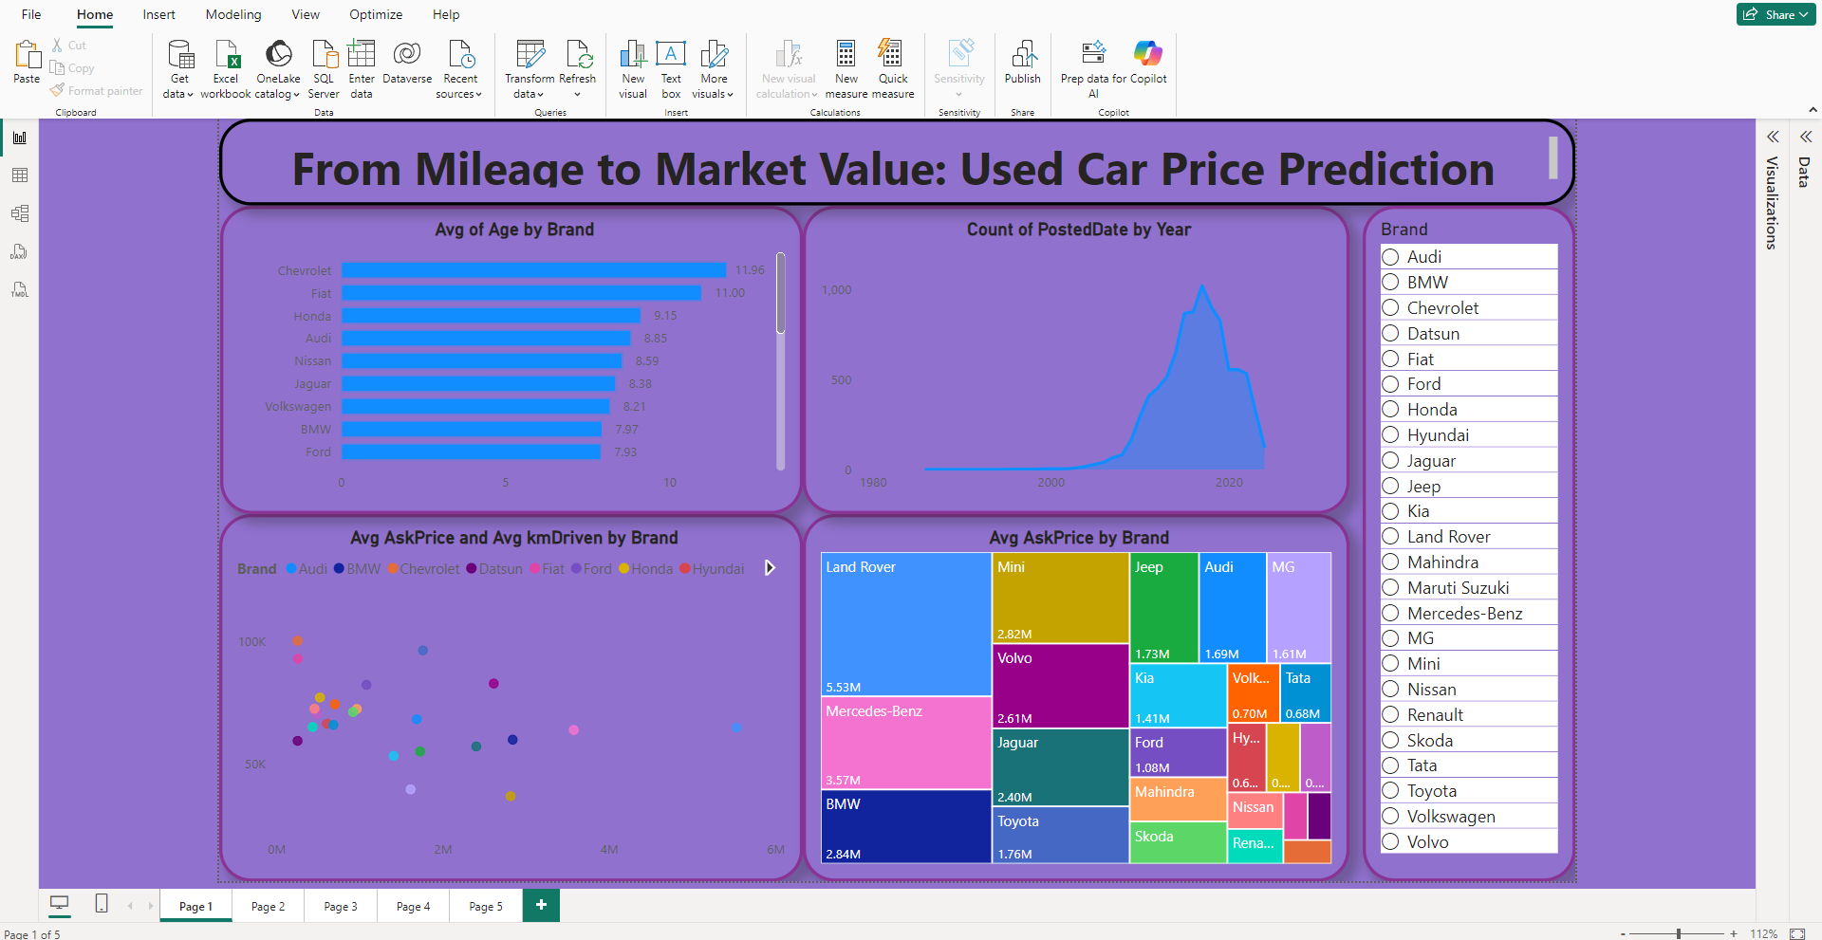
Dashboard in power bi

Slide 11
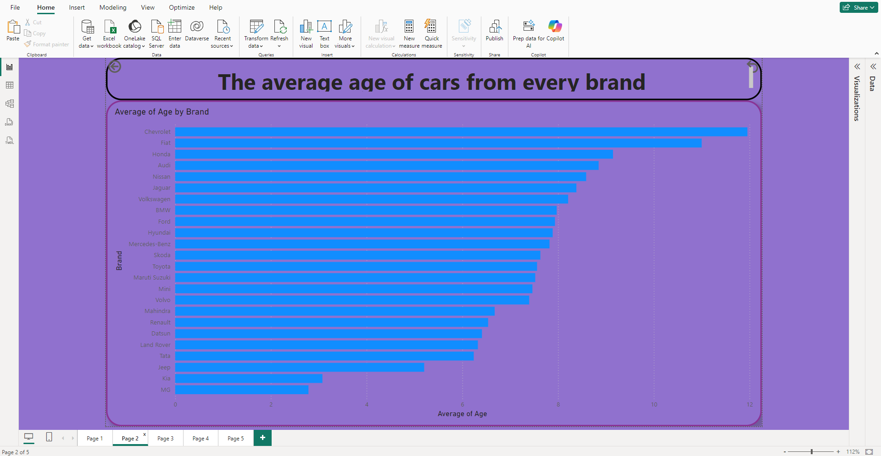

Slide 12
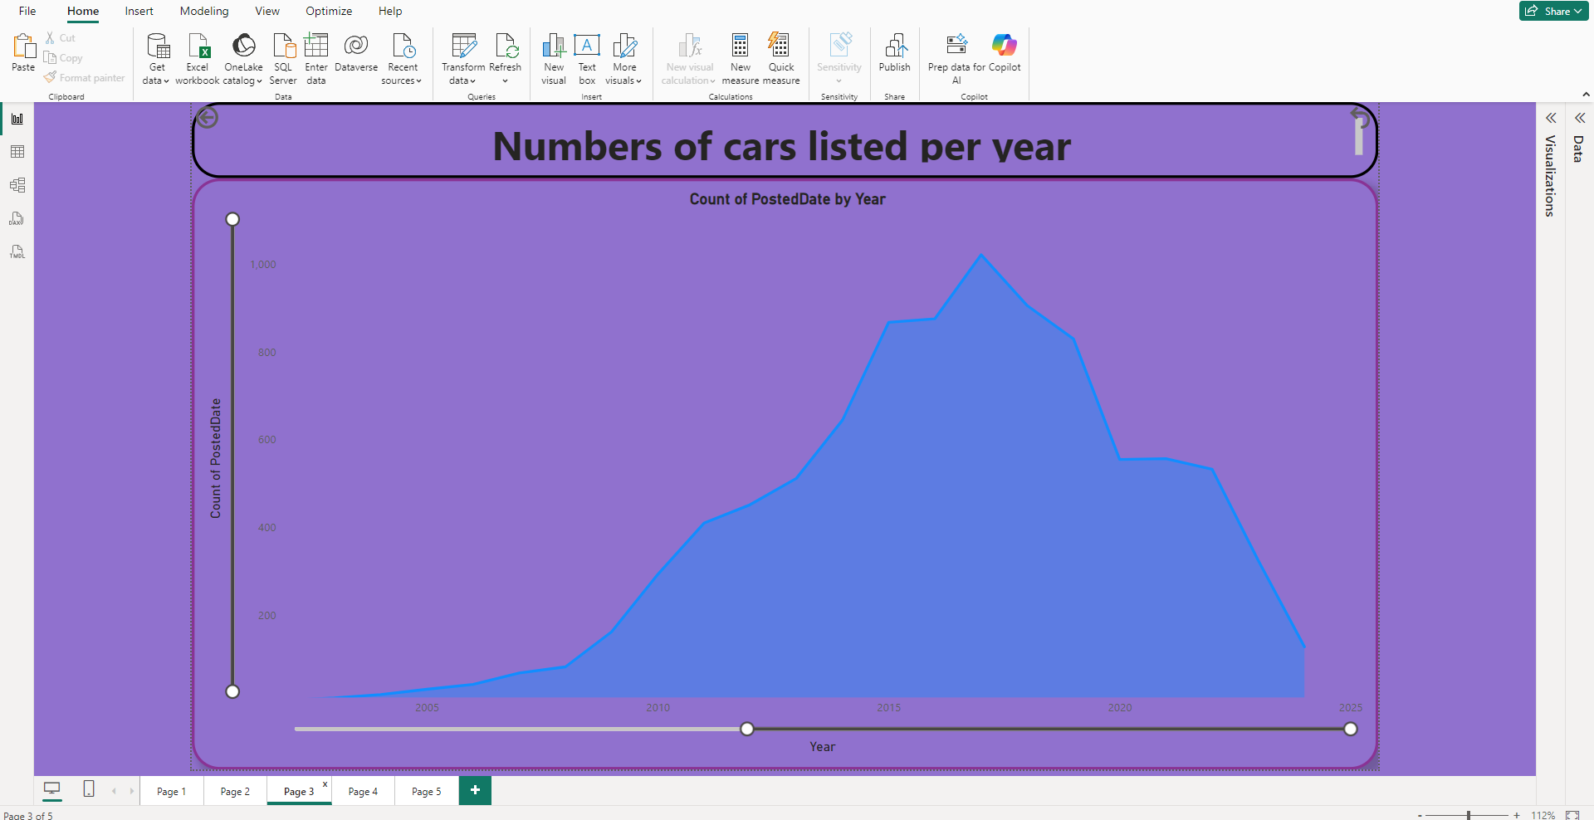

Slide 13
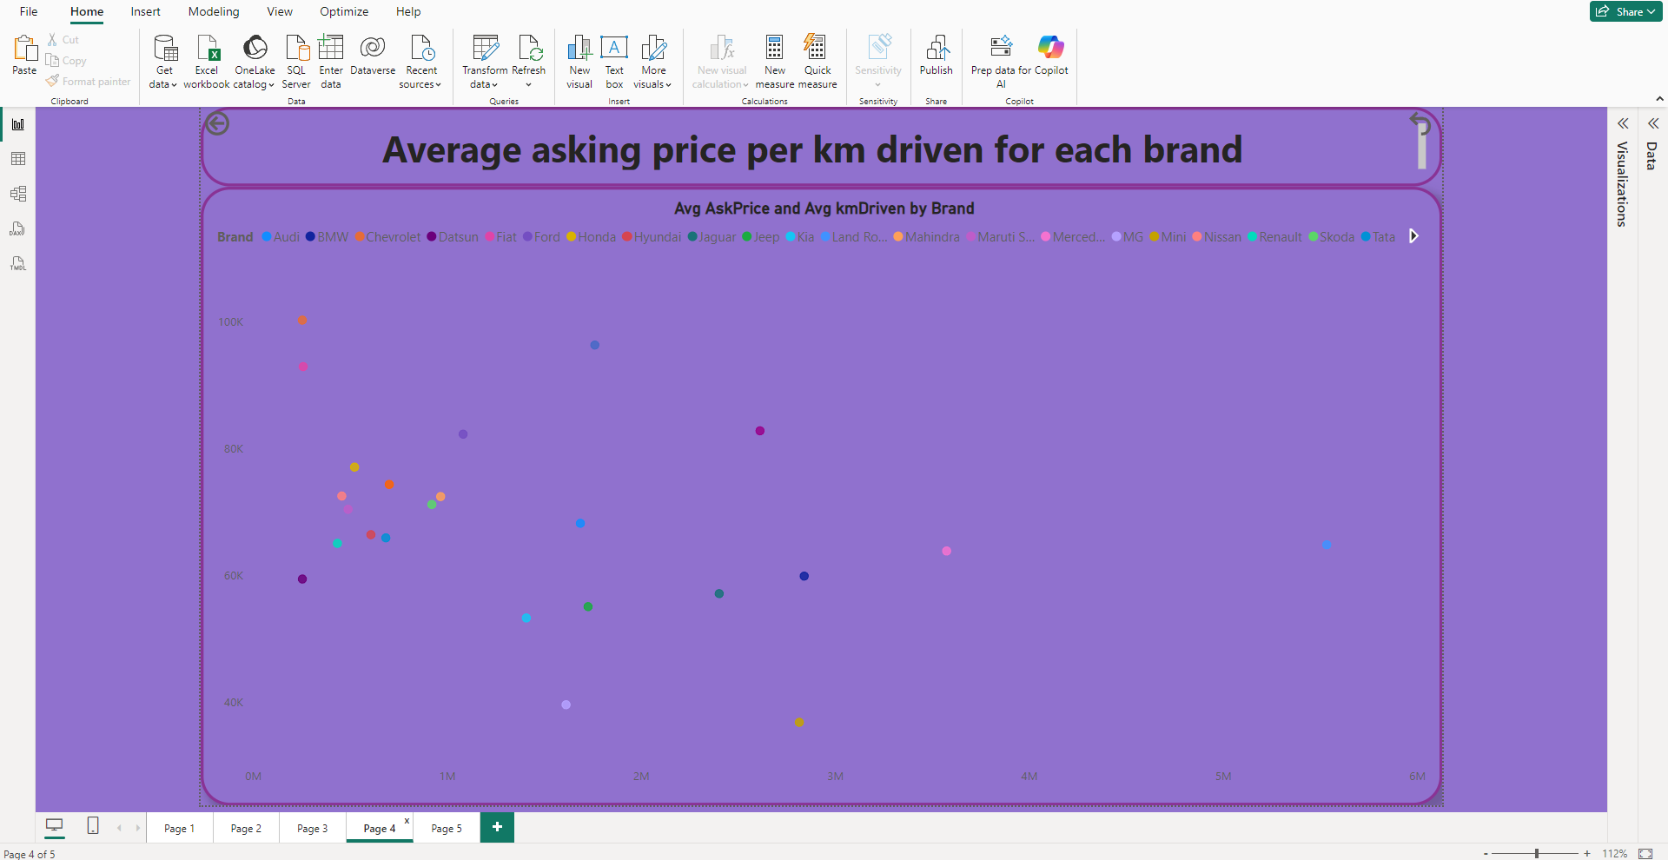

Slide 14
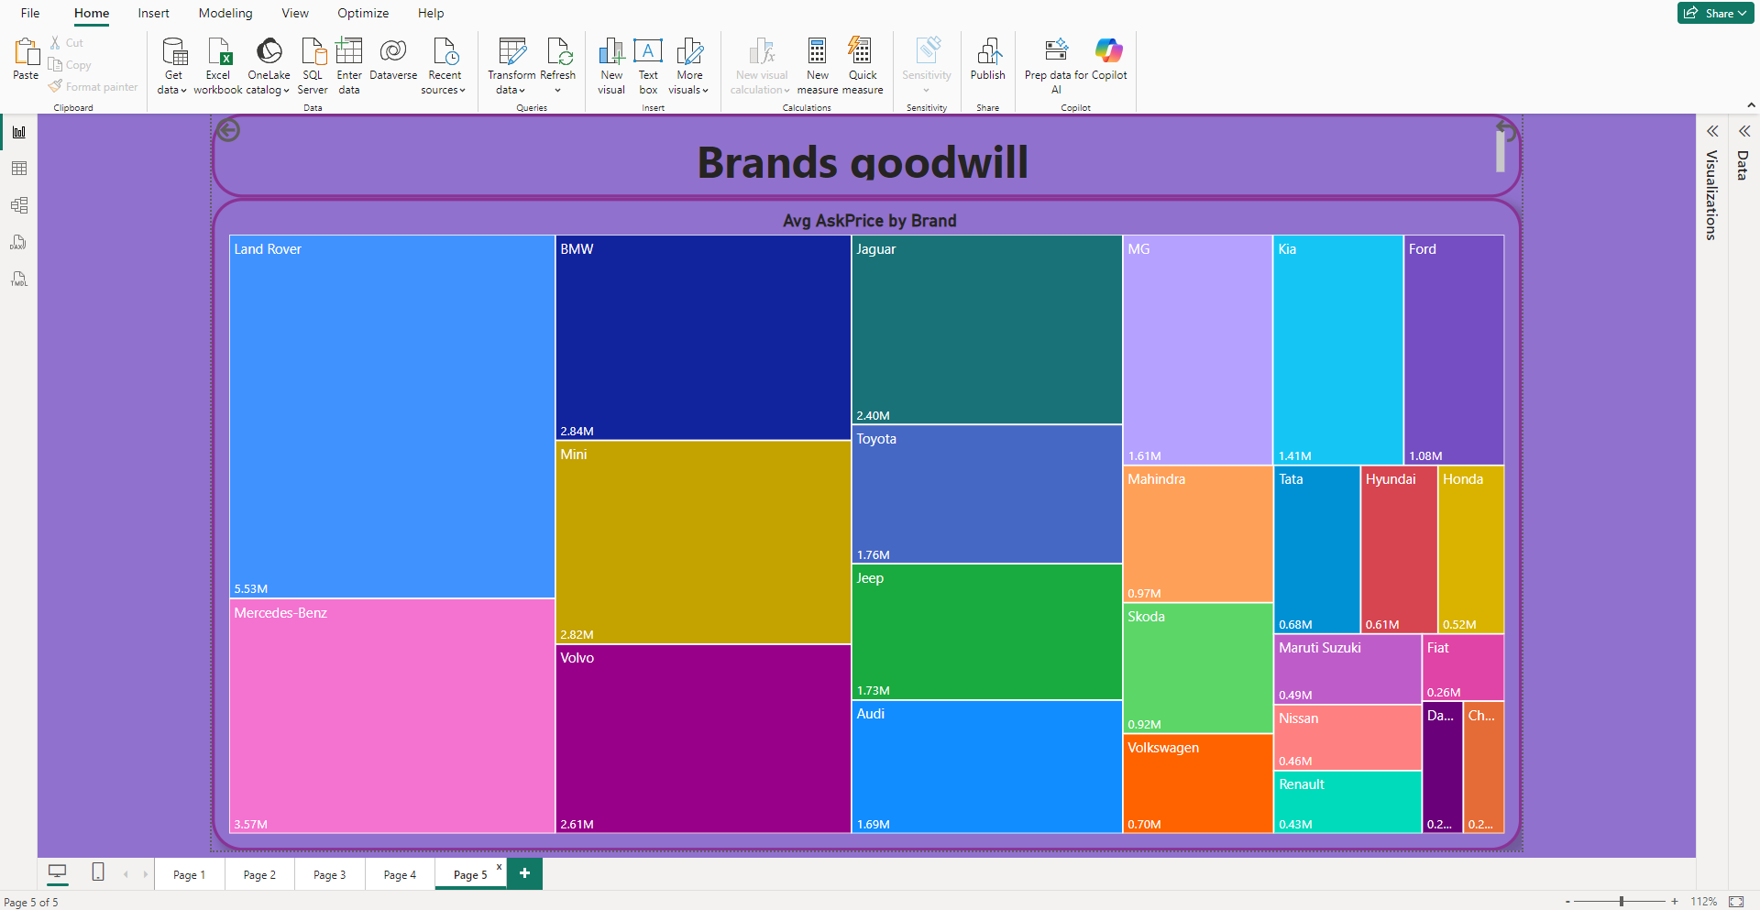

Slide 15
Conclusion
The “From Mileage to Market Value: Used Car Price Prediction” project demonstrates how Microsoft Excel and Power BI can be effectively used to analyze and understand factors influencing used car prices. Through systematic data cleaning, modeling, and visualization, the project highlights the significant impact of mileage and vehicle age on price depreciation, while also showing how brand, fuel type, and transmission play an important role in determining market value.
The interactive dashboards and insights generated through Power BI enable clear interpretation of trends and support data-driven decision-making for buyers, sellers, and analysts in the used car market. Overall, this project proves that meaningful predictive insights can be achieved using business intelligence tools alone, without the need for advanced programming, making the approach accessible and practical for real-world applications.

Slide 16
THANK YOU

